Slide 1
Android Embedded using USB port

Slide 2
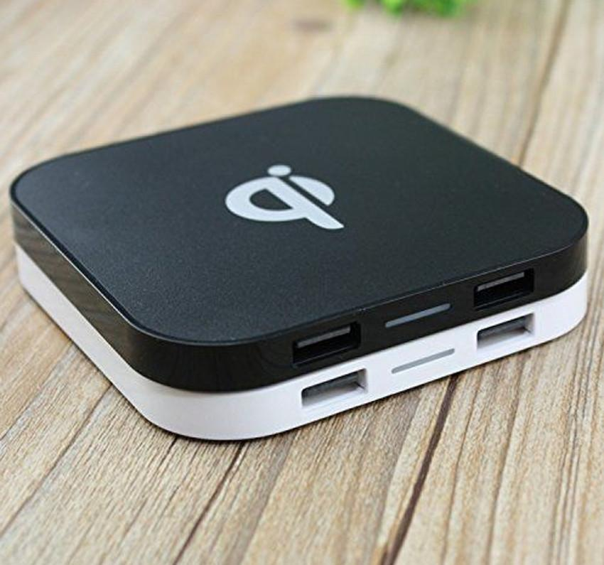
Overview
After exploring the possibility of audio jack what comes to mind is the next and the only left port in the mobile for the communication . The USB port .
Unlike audio jack USB port has a well established protocol . We just had to mould it according to what we intend to do .

Slide 3
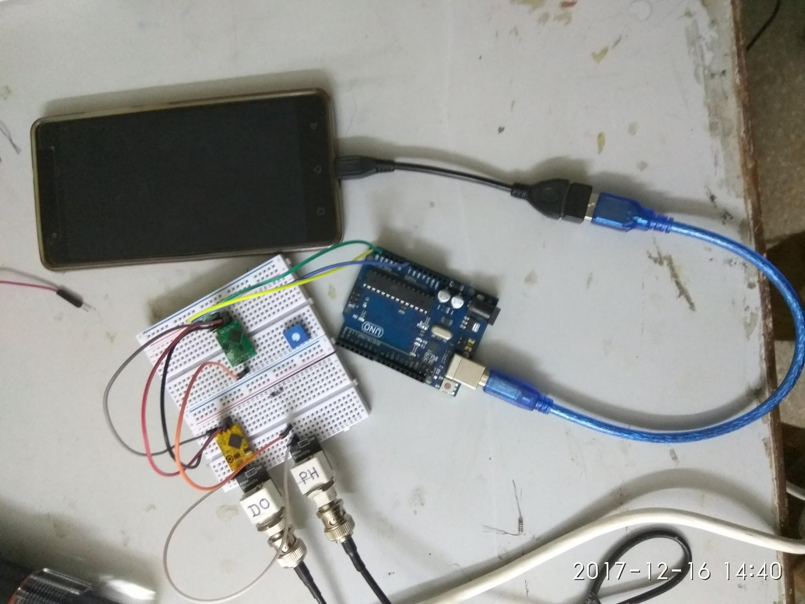
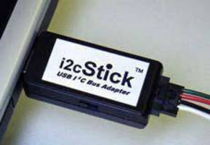
Problem Statement
Setup communication between your phone and an I2c slave bus using the USB port of the phone .

Slide 4

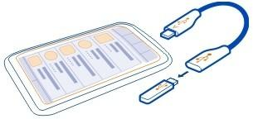
USB Protocol
USB protocol uses the concept of Master and Slave .
If mobile acts as master in our setup then it will not be able to draw power .

Slide 5
Major issues faced
USB protocol is a restricted protocol and it does not allow tampering with itself without jeopardising the data transfer .
The transfer line can either be used for charging the phone or data transfer .
We cannot use any other protocol except USB and it does not allow both tasks simultaneously .
Converting data from I2C to USB .
Connecting Arduino or any “along the line peripheral” (FTDI converter) to Phone .

Slide 6
Overcoming the Issues
Using the USB mini port we plan on making an Adapter which will periodically switch the connection between power supply and communication mode .
Data conversion in between protocols will be done using Arduino .
Arduino acts as mediator by converting USB to serial to I2C and vice versa for reverse data transfer .

Slide 7
Exploring Possibilities
MASTER INTER-MEDIARY
Either we design a board which acts as a plug and play i.e. just connect the board and it will charge and transfer data altogether . One such solution exists known as IOIO board manufactured by spark fun electronics . But it turns out it is very expensive and we can devise a cheaper alternative with some research .
CHEAPER ALTERNATIVE
This is the solution we worked upon . Using an USB to I2C converter and communicating with a pre-programmed processor using an API installed in phone . Using the adapter to switch from time to time or how to user wants it to be . Phone will charge for the time it does not communicate and is connected to power supply as soon as it stops sending data .

Slide 8
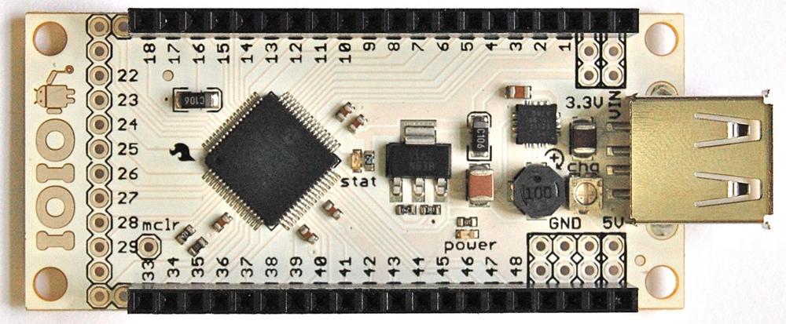
Existing Solutions
IOIO Board
~pronounced as yoyo board
IOIO board uses a PIC microcontroller that allows android to communicate with external
Electronics . We can connect it via phone and it solves our problem to a greater extent
Since it charges and connects phone for data simultaneously . Hence eliminating the need
to make the Adapter .

Slide 9
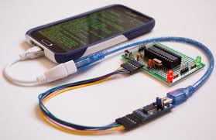
ADVANTAGES OF OUR ALTERNATIVE
Our alternative strips off all the unnecessary components present on the IOIO board .
It uses minimum circuitry and makes maximum out of the phone resources hence does not need a processor .

Slide 10
What we intend to do ?
To be able to communicate effectively and quickly to a bus of sensors we chose I2c protocol over SPI . We will use an FTDI converter to switch between the protocols in the midway of data being transferred to the phone .
We made a working prototype which more or less did the same thing what we wish to do just to check the connectivity of arduino over phone .
Turns out arduino can be connected to the phone .
Now we plan on removing Arduino since it injected serial communication in between hence what we prototyped was not exactly i2c to USB . rather it was i2c to serial to USB .

Slide 11
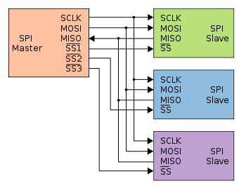
Why I2C over Serial ?
I2c required 2 wires but SPI required four .
I2c operates on less power than SPI .
SPI has compatibility issues .
I2c supports multiple slaves on a single bus but SPI requires several arrangements to be done every time we add a new slave rendering I2c more handy .
I2c is cheaper to implement .

Slide 12
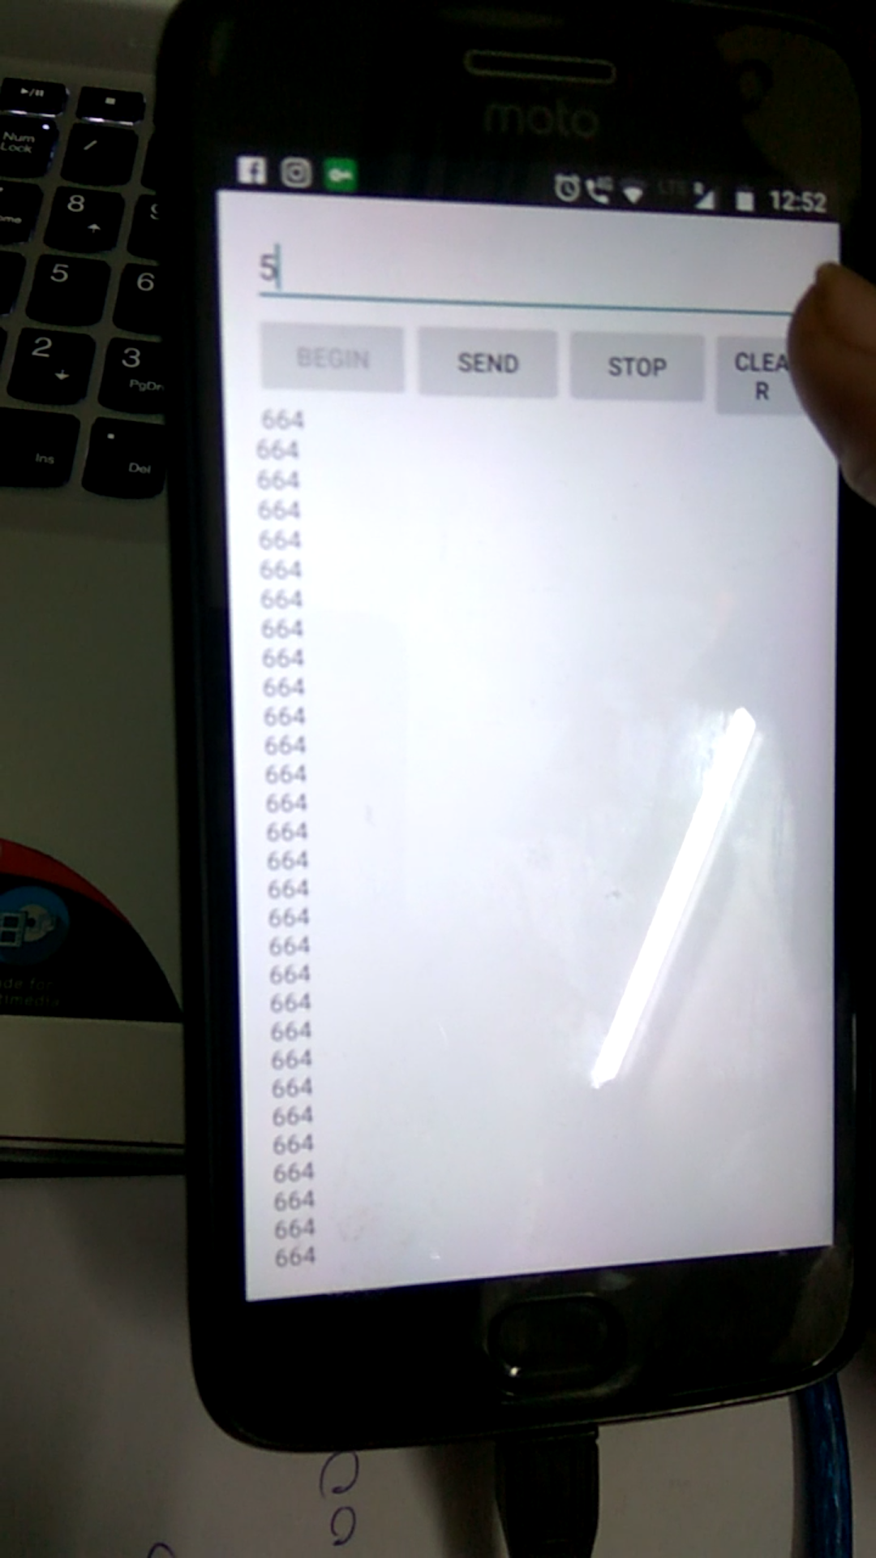
What we did .
We fed the Arduino code of I2C protocol onboard and connected it to the phone using USB OTG.
We installed the App for communication with arduino in our mobile phones and connected an I2C bus on Arduino .
We were successfully able to retrieve data from multiple sensors on our phone screen .

Slide 13
FUTURE PLANS
Develop custom App to send and receive data according to our need with proper user interface to communicate with multiple sensors .
Repacing Arduino with FTDI converter or any suitable peripheral processor which will communicate without switching into serial mode in between .
Make an adapter which will switch between power supply and data sending as we wish .

Slide 14
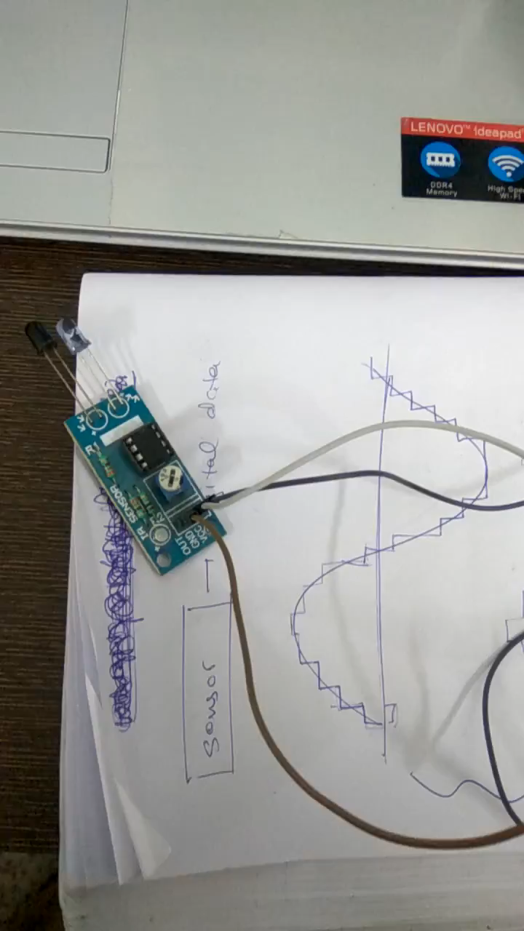
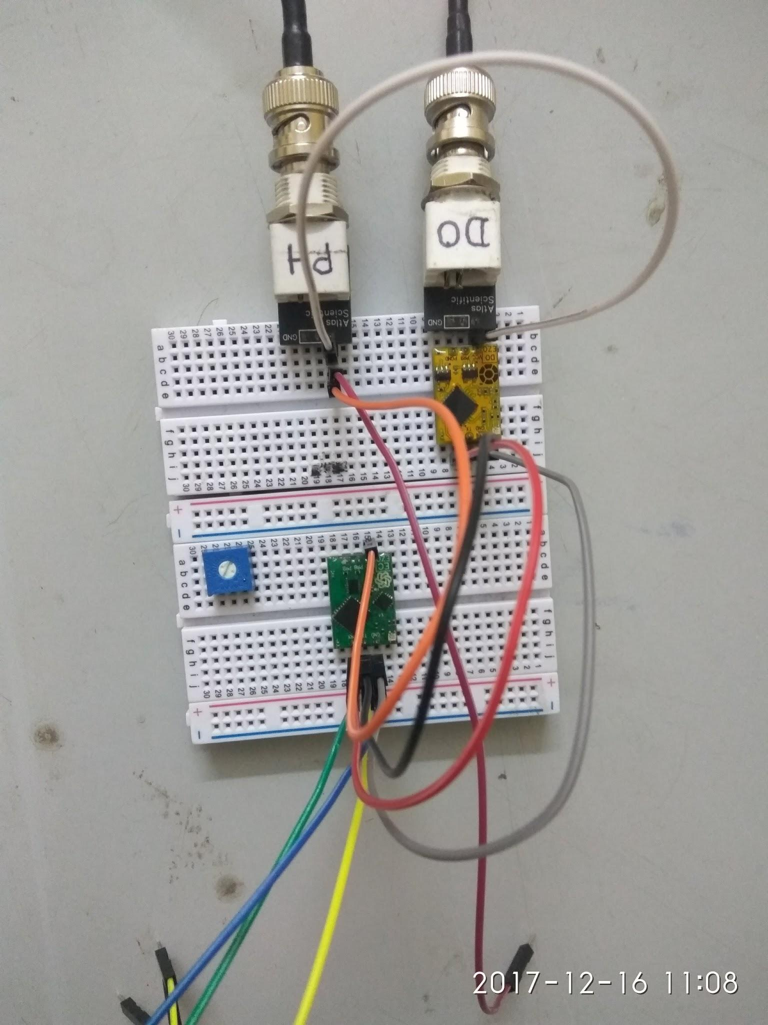

Slide 15
THANK YOU

